Slide 1

Khulna University of Engineering & Technology
CSE 3200 System Development Project
A Smart Meal Recommendation System
Supervised by
Presented by
Dipannita Biswas
Lecturer
Department of Computer Science & Engineering
Khulna University of Engineering & Technology
Sajjad Hossen
Roll: 1907074
Sumiya Islam Barsha
Roll: 1907076

Slide 2
Overview
01
02
03
04
05
06
Background
Problem
Solution
Objectives
How the application works
Implementation
07
08
09
10
11
Underlying theory of our system
Tools , Technology and language
Limitations & Future Scope
Conclusion
Reference
03/12/2023

Slide 3
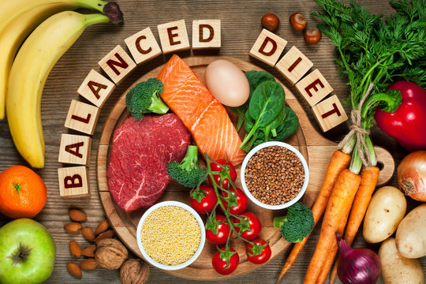
A Smart Meal Recommendation System
Background
Effective meal management plays a pivotal role in contemporary health strategies, serving as a preventive measure against various noncommunicable diseases.
So, it is very essential to follow a systemic approach to daily meal planning, emphasizing nutrition-focused information to effectively regulate essential dietary components.
03/12/2023

Slide 4
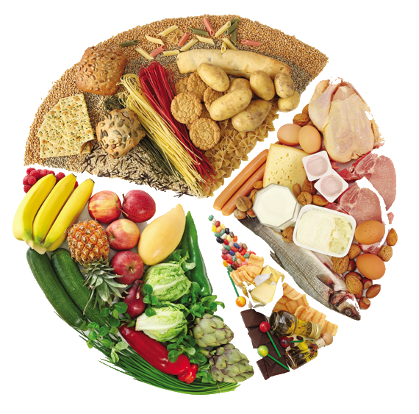
Problem
The lack of knowledge about proper diet plans
The absence of a structured meal plan system
The widespread availability of junk food
Habitual eating patterns due to comfort and familiarity
03/12/2023

Slide 5
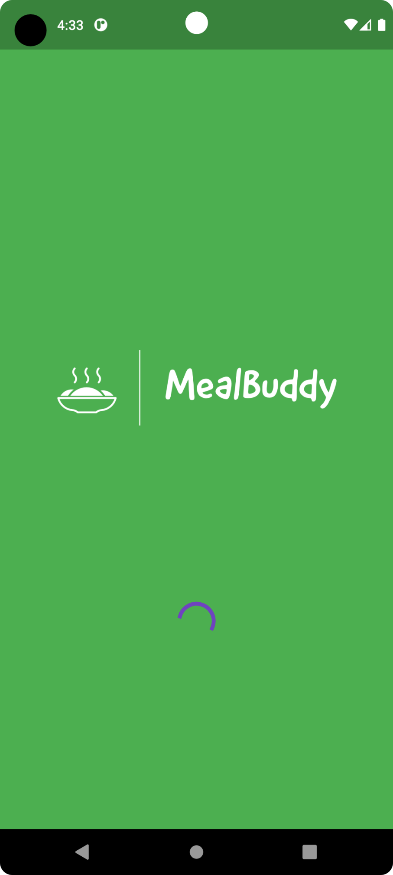
Solution
Developing an android application
named
MealBuddy
considering the following objectives
03/12/2023

Slide 6
Objectives
Promote healthier eating habits by encouraging healthier eating patterns through structured meal plans
Promote personalized nutritional guidance based on individual nutritional needs and preferences
Ensure integrated grocery management that align with the planned meals
03/12/2023

Slide 7
How the application works?
01
02
03
04
Data Collection
DRI Tool
Meal Suggestion
Grocery Suggestion
Collected data during register:
Age
Gender
Height
Weight
Kcal and macronutrient level is calculated from
BEE equation
Meal suggestion is given based on Decision Tree Algorithm
Grocery suggestion is given based on the items user has in the grocery list.
03/12/2023
6

Slide 8
Implementation
03/12/2023

Slide 9
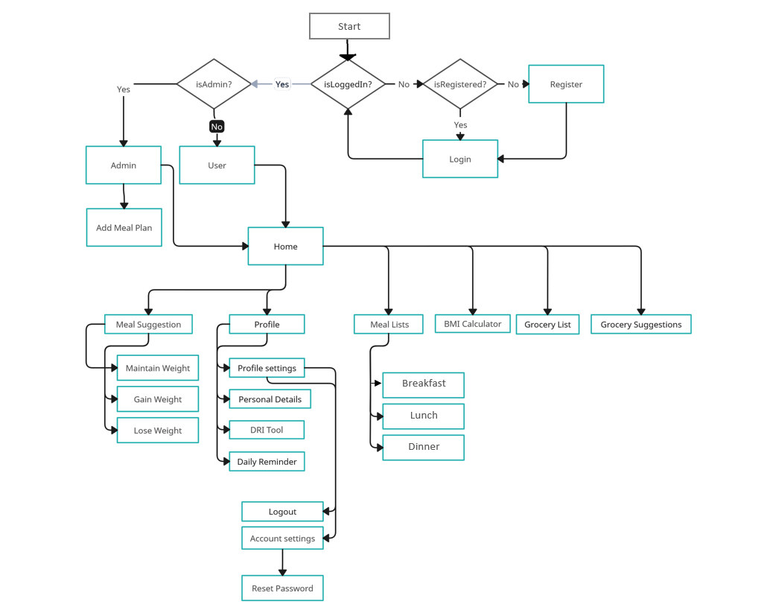
Design
Data Flow Diagram
System Architecture
Figure No. : 01
03/12/2023

Slide 10

Introducing
03/12/2023

Slide 11
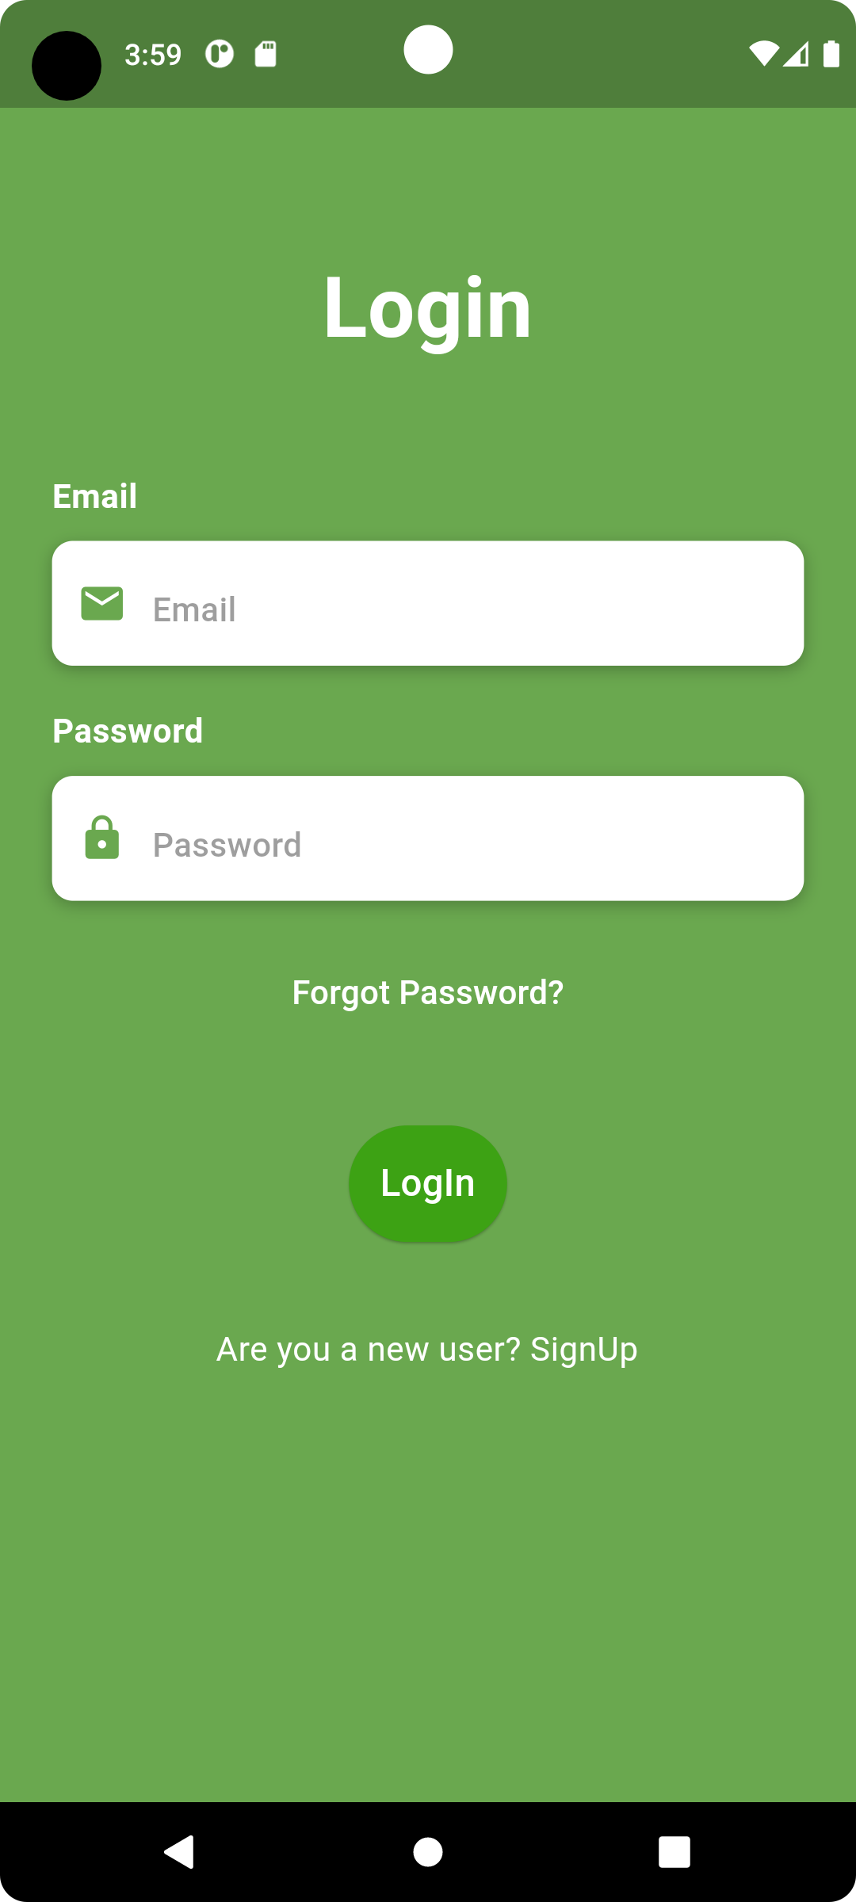
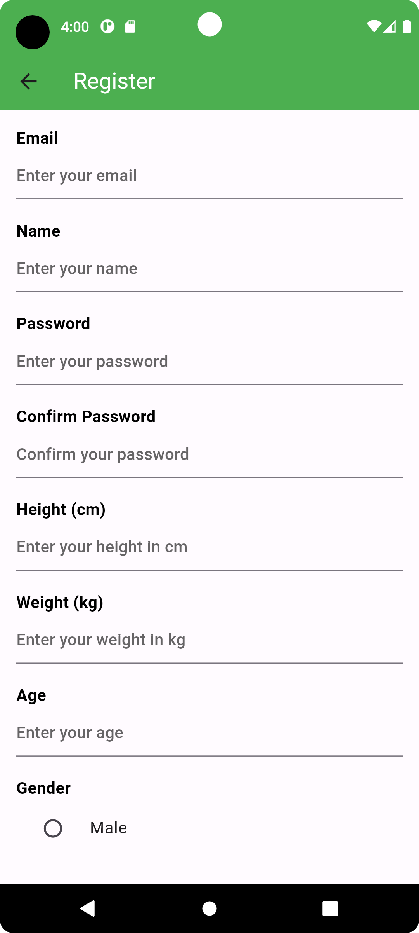
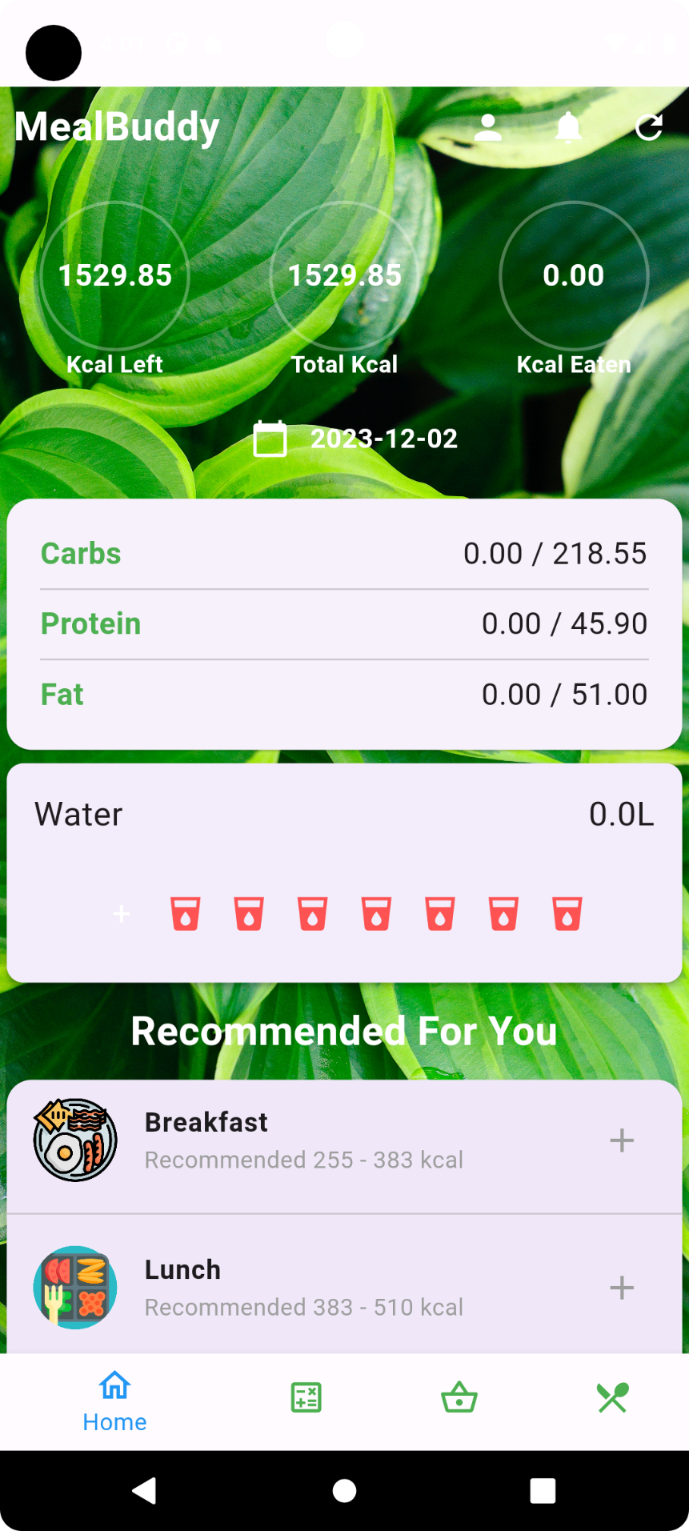
Splash Screen
Login Screen
Signup Screen
Home Screen
03/12/2023
Figure No. : 02
10

Slide 12
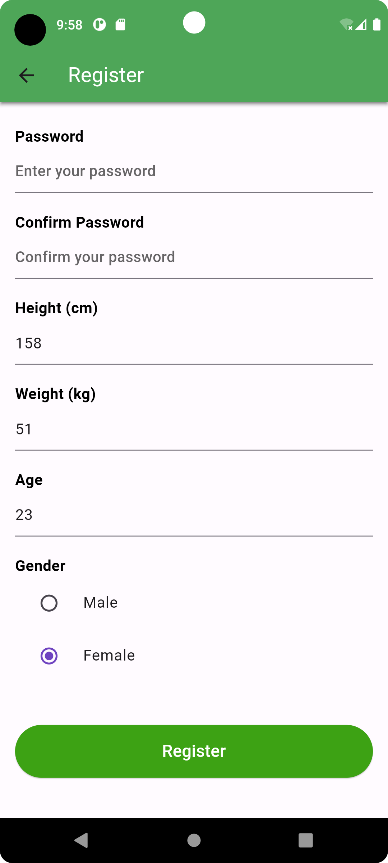
User data input
Required field:
Age
Height
Weight
Gender
These entries are used as features to predict the meal plans
Figure No. : 03
03/12/2023
11

Slide 13
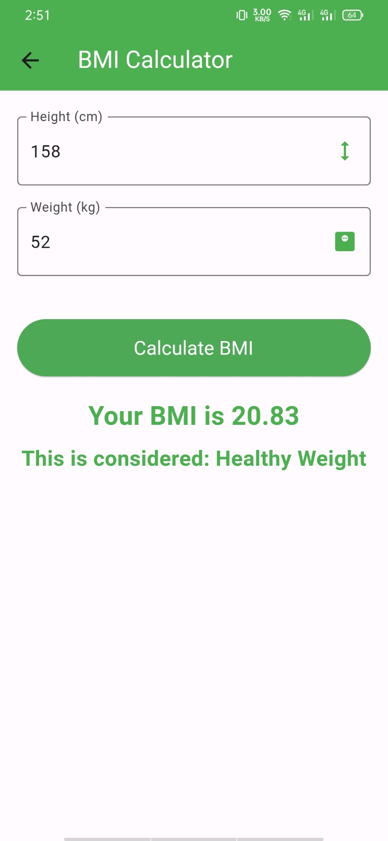
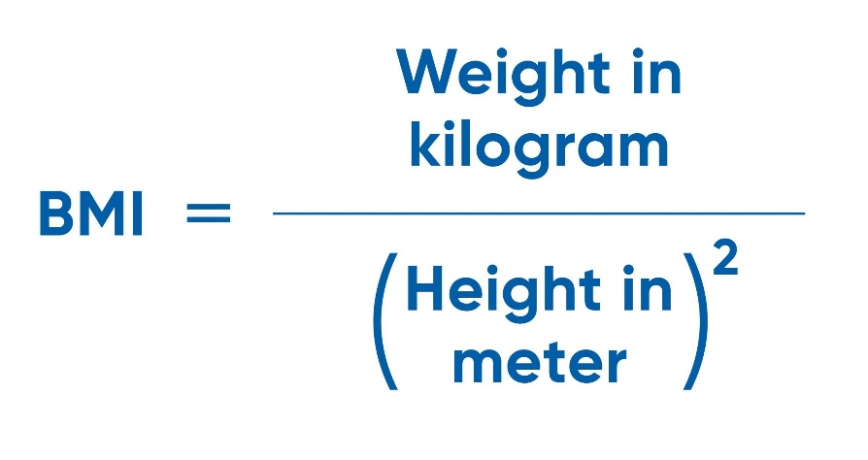
Checking health condition
The BMI result depends on height and weight:
underweight (<18.5)
a healthy weight (>= 18.5 && <= 24.9)
overweight (>= 25 && <= 29.9)
obese (>30)
Figure No. : 04
03/12/2023
12

Slide 14
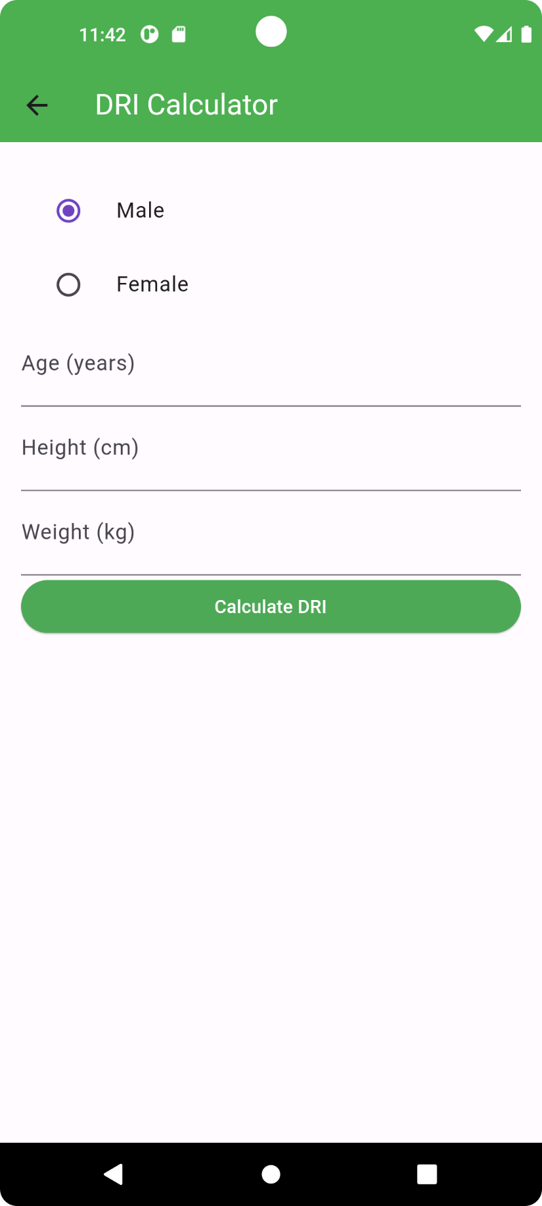

Adjust daily macronutrients
Basal Energy Expenditure (BEE), also known as Basal Metabolic Rate (BMR), is the amount of energy expressed in calories that a person needs to keep the body functioning at rest.
upon giving height in cm, weight in kg, age in years , user will be shown their total kilocalorie and carb, fat, protein amount on daily basis.
Men: BEE = 66.5 + 13.8(W) + 5.0(H) - 6.8(A)
Women: BEE = 655.1 + 9.6(W) + 1.9(H) - 4.7(A)
Figure No. : 05
03/12/2023
13

Slide 15
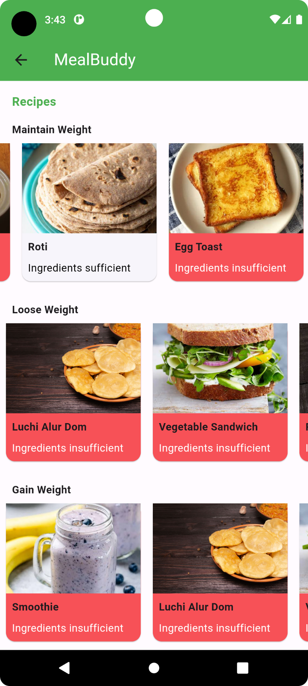
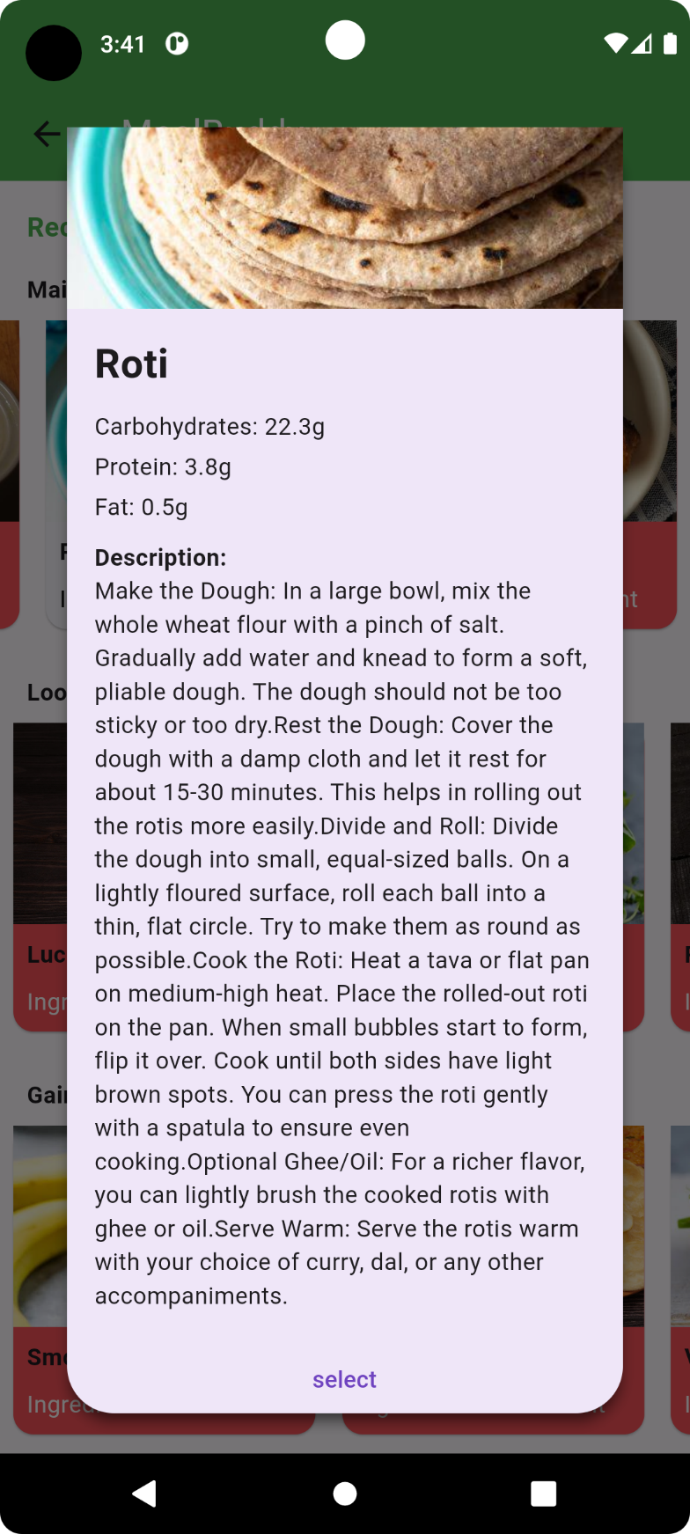

Select meal plans
upon clicking the “select” button kilocalorie and the other nutrients will get adjusted excluding this selected meal and the meal will be counted as eaten by the user.
Figure No. : 06
03/12/2023

Slide 16
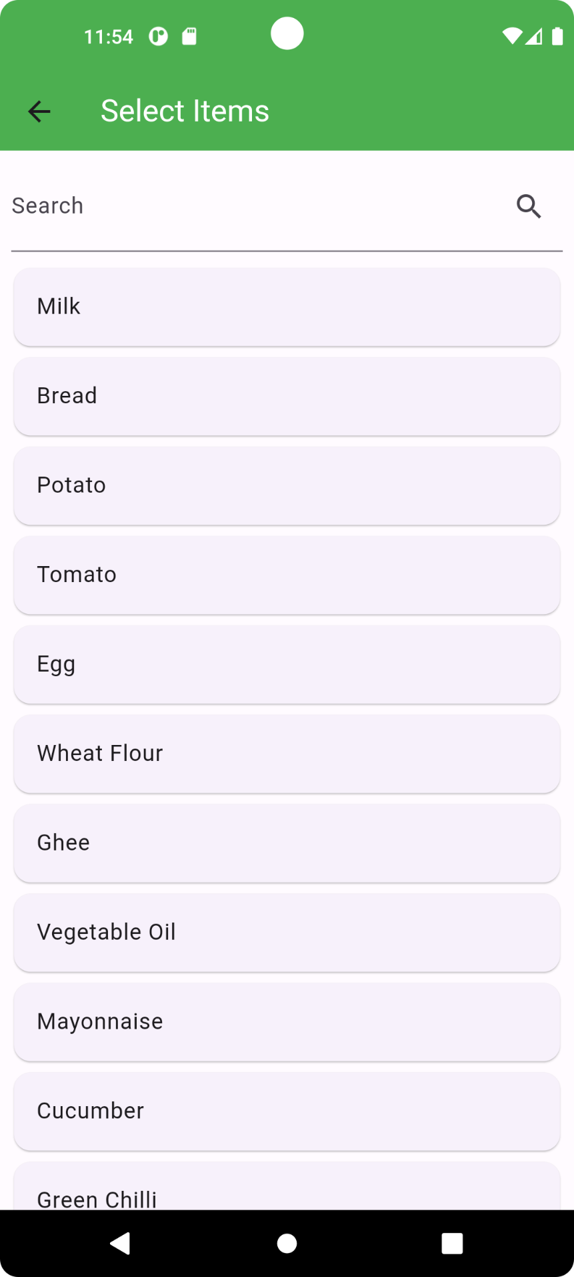
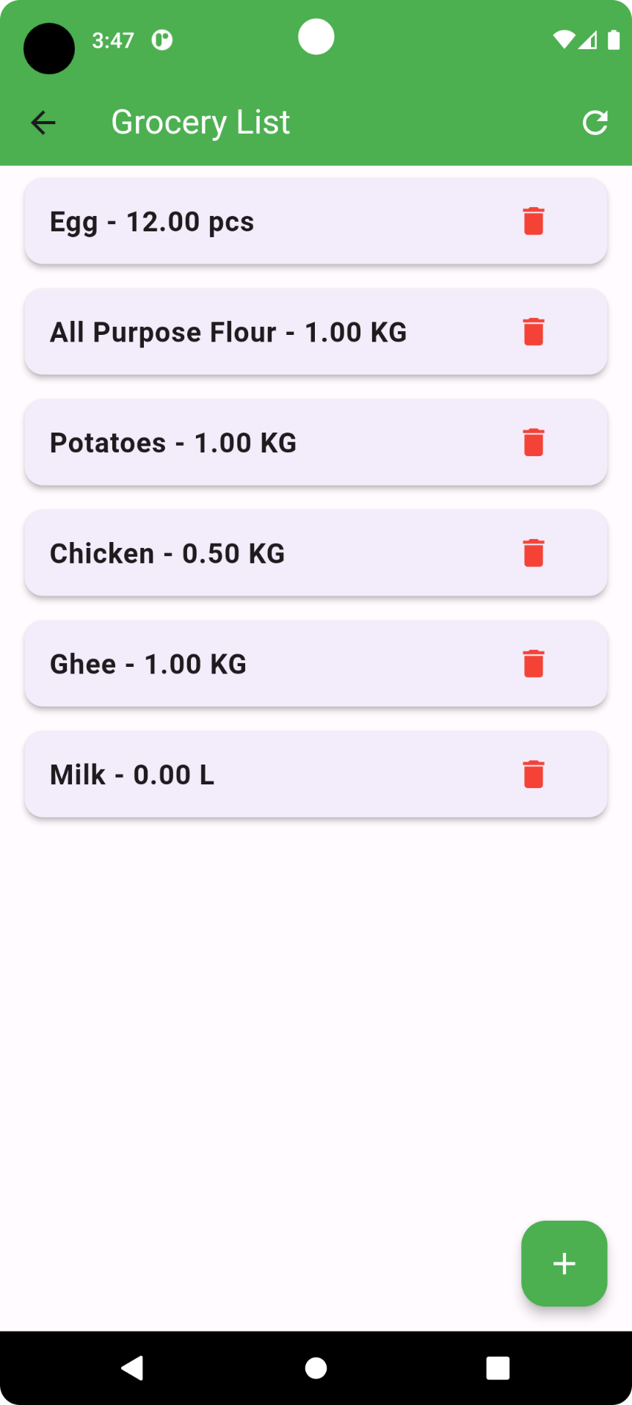
Update grocery items
upon clicking the “floating action” button, user will get option to add the existing items in the grocery list
Figure No. : 07
03/12/2023
15

Slide 17
Underlying theory
of our System
03/12/2023

Slide 18
Related Theories
Nutritional Science
Uses food science to suggest what matches your calorie needs.
Decision Theory
Selects food items by evaluating their caloric content against dietary goals to meet nutritional targets.
Greedy Algorithms
Picks the closest match in calories first to make a simple, immediate choice.
Sorting Algorithms
Organizes food items in ascending order of caloric differences using sorting methods.
03/12/2023

Slide 19
How it works?
Decision making
MealBuddy decides how much user should eat for each meal
Input Personal Details
Calculate Nutritional Needs
Used DRI tools
To calculate person's daily calorie needs. For men
Daily calorie need(kcal) = 66.5 + 13.8 * weight(KG) + 5.0 * height(cm) – 6.8 * age(years)
Other related formulas
To determine daily needs for carbs, fat, and protein based on a person's calorie needs, age, height, weight, and gender.
Daily fat intake(g) = Daily calorie need (kcal) * 0.30 / 9
Daily carbohydrate intake(g) = Daily calorie need (kcal) * 0.55 / 4
Daily protein intake(g) = weight(KG) * 0.9
03/12/2023

Slide 20
How it works?(Cont.)
Meal Suggestions
Recommend food with the item closest to the target kcal at the top
List of Food Items
Caloric Difference Calculation
Ranking
Personalized Suggestions
Figure No. : 08
03/12/2023

Slide 21

Tools , Technology & language
01
FLUTTER
02
ANDROID STUDIO
03
DART
04
FIREBASE DATABSE
05
GitHub
03/12/2023
20

Slide 22
Limitations & Future Scope
Limitations:
User end meal plan addition
Consideration about macronutrients other than carb, fat, protein such as vitamin, iron etc.
Preferences on activity level
Taste preferences
Future Scope:
Better Meal Suggestions
Easy Grocery Management with Photos
Learning User Preferences Over Time
Working with Nutrition Experts
Custom Recipe Creation
03/12/2023

Slide 23
Conclusion
Our Food Recommender System is a major step forward in using technology to customize nutrition and manage health.
Our app offers personalized meal suggestions and grocery management tools and caters to specific dietary needs.
It simplifies meal planning and provides users with knowledge and resources to make healthier food choices
03/12/2023

Slide 24
References
https://www.calculator.net/bmi-calculator.html
https://www.nal.usda.gov/human-nutrition-and-food-safety/dri-calculator
https://www.k-state.edu/paccats/Contents/Nutrition/PDF/Needs.pdf
01
02
03
03/12/2023
23

Slide 25
Thank You
03/12/2023
24

